Slide 1
Building a Reproducible Equity Report in R
Randall Madsen, Ember Education
Michael Gonzalez, UC Merced

Slide 2
Objectives
01
02
03
04
Learn the basics of the RStudio environment
Import data into RStudio
Perform basic data cleaning
Build a simple, reproducible data viz report

Slide 3
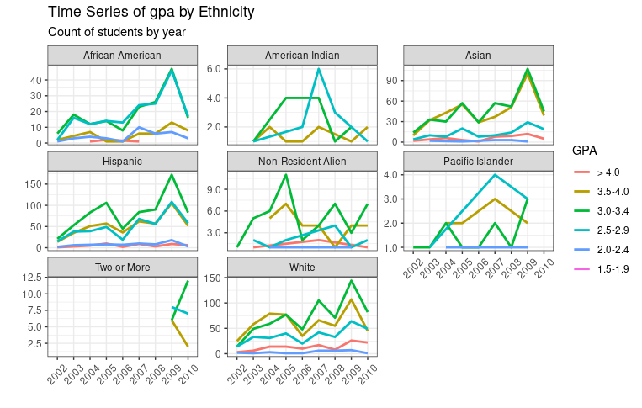

Slide 4
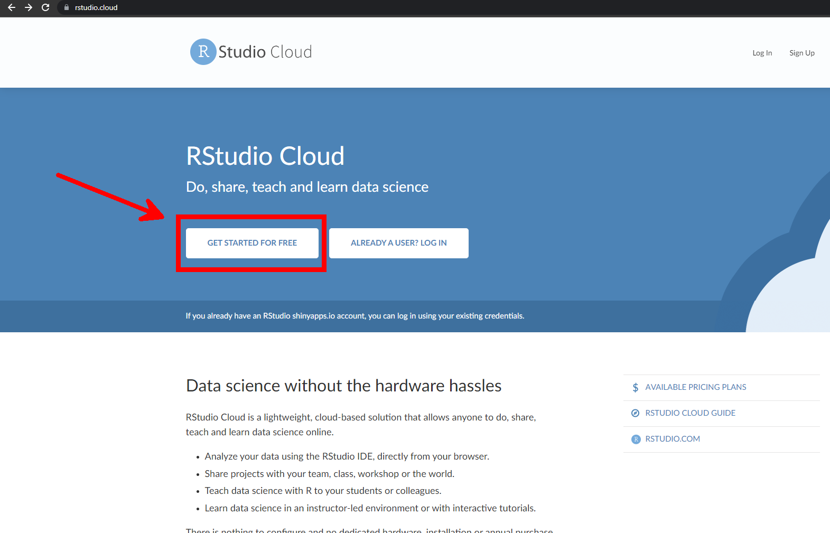
Go to rstudio.cloud

Slide 5
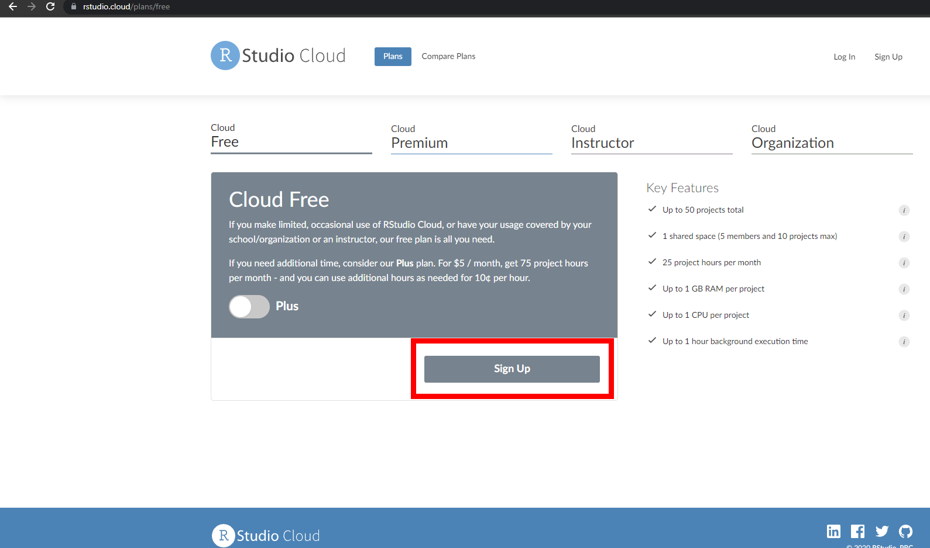

Slide 6
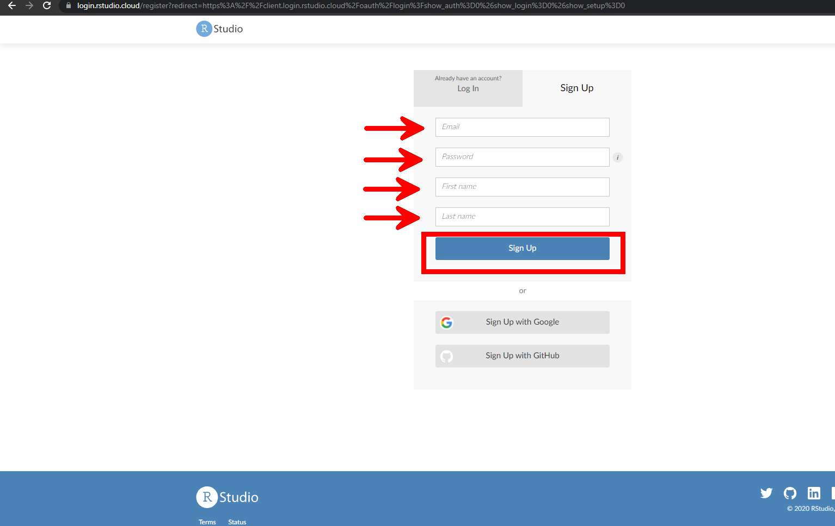

Slide 7
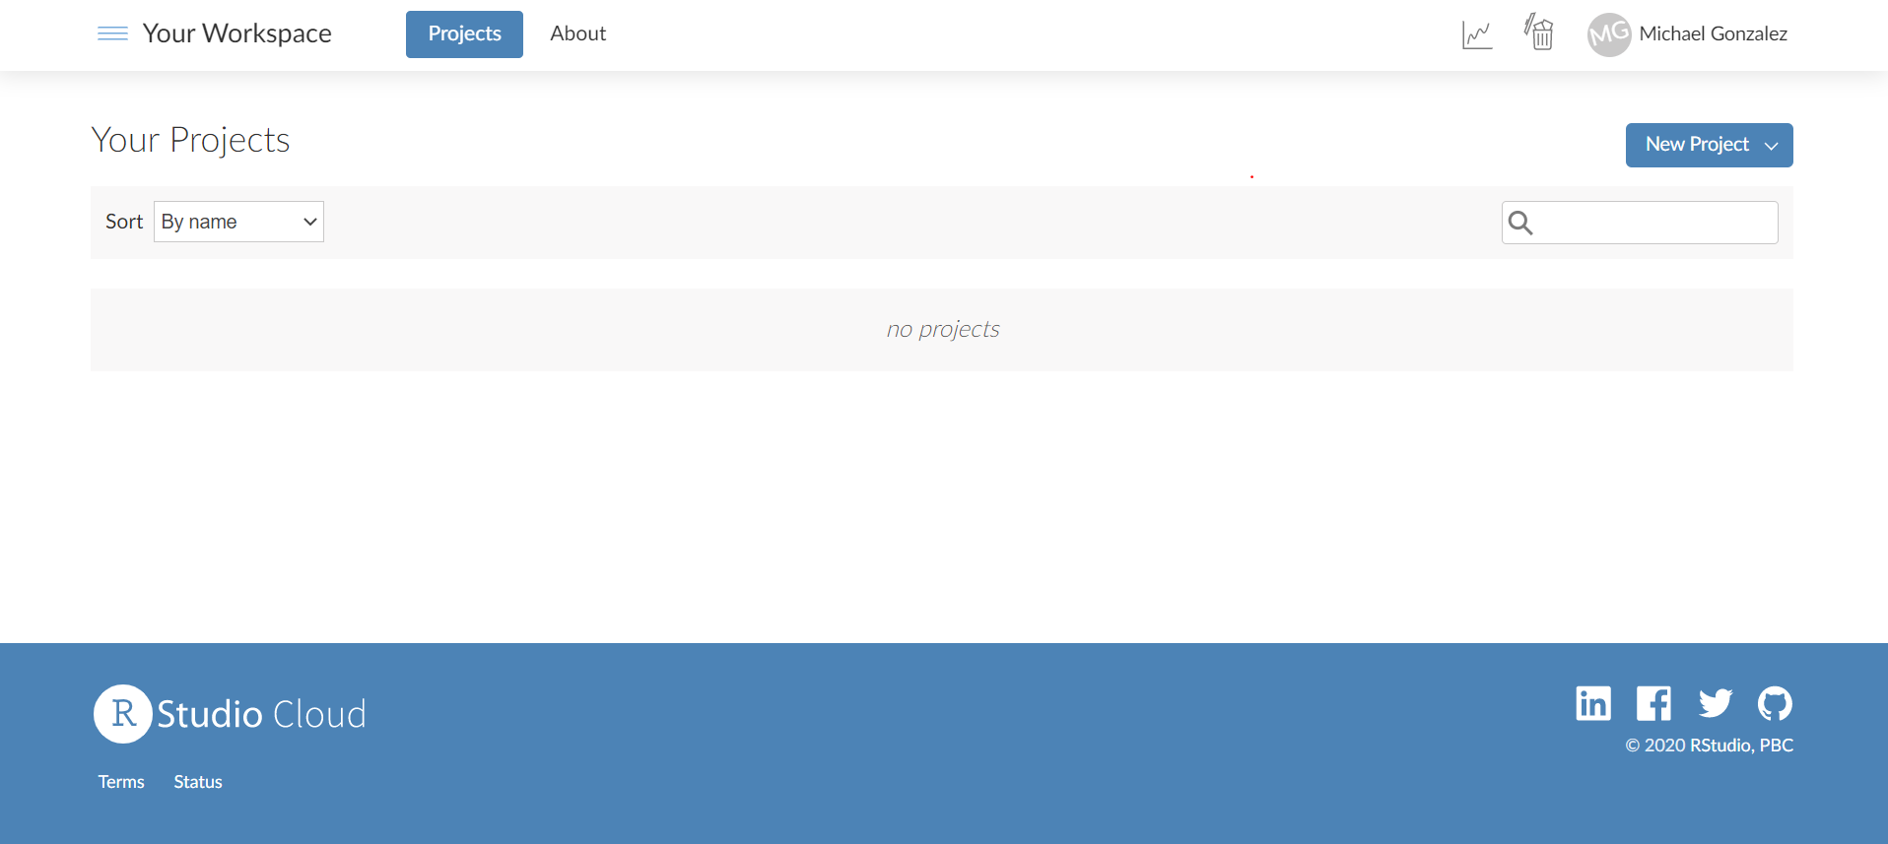
New Project

Slide 8
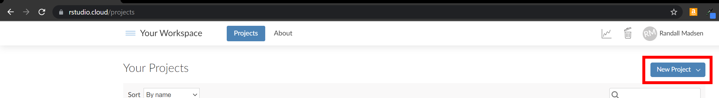
New Project

Slide 9
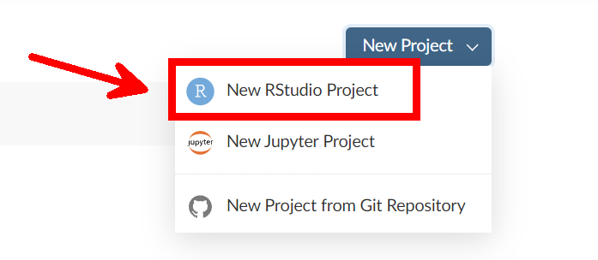
New Project

Slide 10
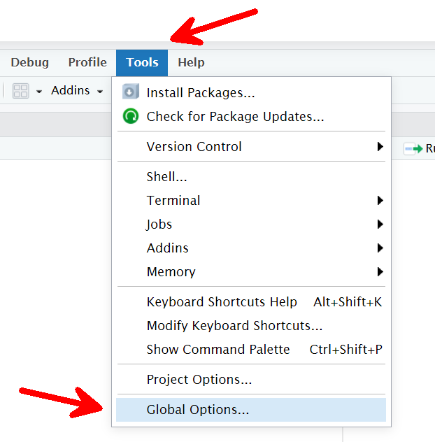
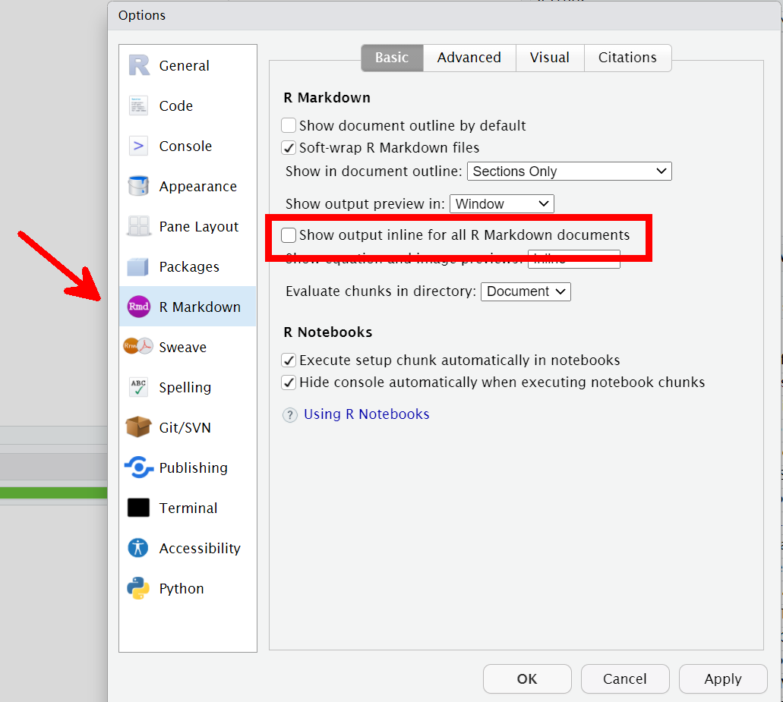
Project Options

Slide 11
